Slide 1

NRI INSTITUTE OF INFORMATION SCIENCE & TECHNOLOGY - BHOPAL (M.P.)
Project presentation
TITLE
“YOUTUBE TRANSCRIPT SUMMARIZER”
Guided by Team members
PROF. MRIDULA ROHIT GUPTA
VIJAY PANDEY
PRASHANT ANAND
DEPARTMENT OF COMPUTER SCIENCE AND ENGINEERING

Slide 2
INTRODUCTION
AIM:-
Project aim is to developed a tool that can generate a summary of the youtube video in the text format by the youtube link.
The “YouTube Transcript Summarizer” generate a summary of the YouTube video, by analyzing the transcript(subtitle) of the video content.

Slide 3
Objective:
The primary objective of this project is to generate a summary of YouTube videos by condensing their transcript.
The objective of this transcript summarizer is to provide a quick and easy way to understand the main points of a video without having to watch the entire video.

Slide 4
Why YouTube Transcript Summarizer??
Enormous number of video recordings are being created and shared on the Internet throughout the day.
It has become really difficult to spend time watching such videos which may have a longer duration and sometimes our efforts may become futile if we couldn't find relevant information out of it.
Summarizing transcripts of such videos automatically allows us to quickly lookout for the important patterns in the video and helps us to save time and effort to go through the whole content of the video.

Slide 5
Stages in transcript summarizer
First we provide YouTube video link as input that we want to summarize.
YouTube API get the transcript of video with the help of video id that present in video link.
Analysis and text summarization produces a summary containing important sentences from the video transcript(subtitle).
Summary of a YouTube video is display in a text format.

Slide 6
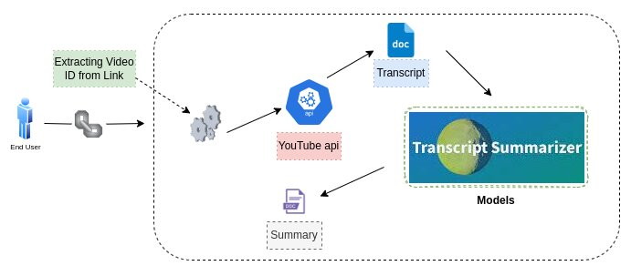
How its work

Slide 7
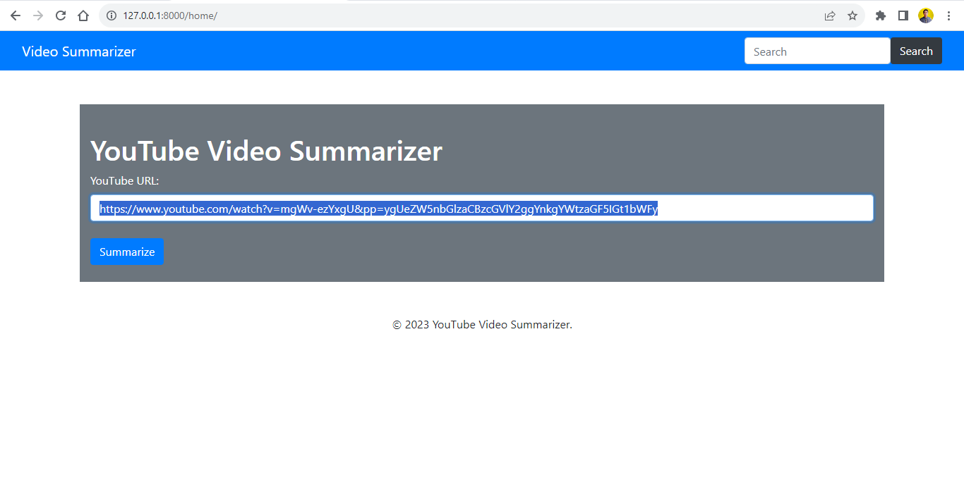
Demo (ScreenShots)
Screenshot :- 1

Slide 8
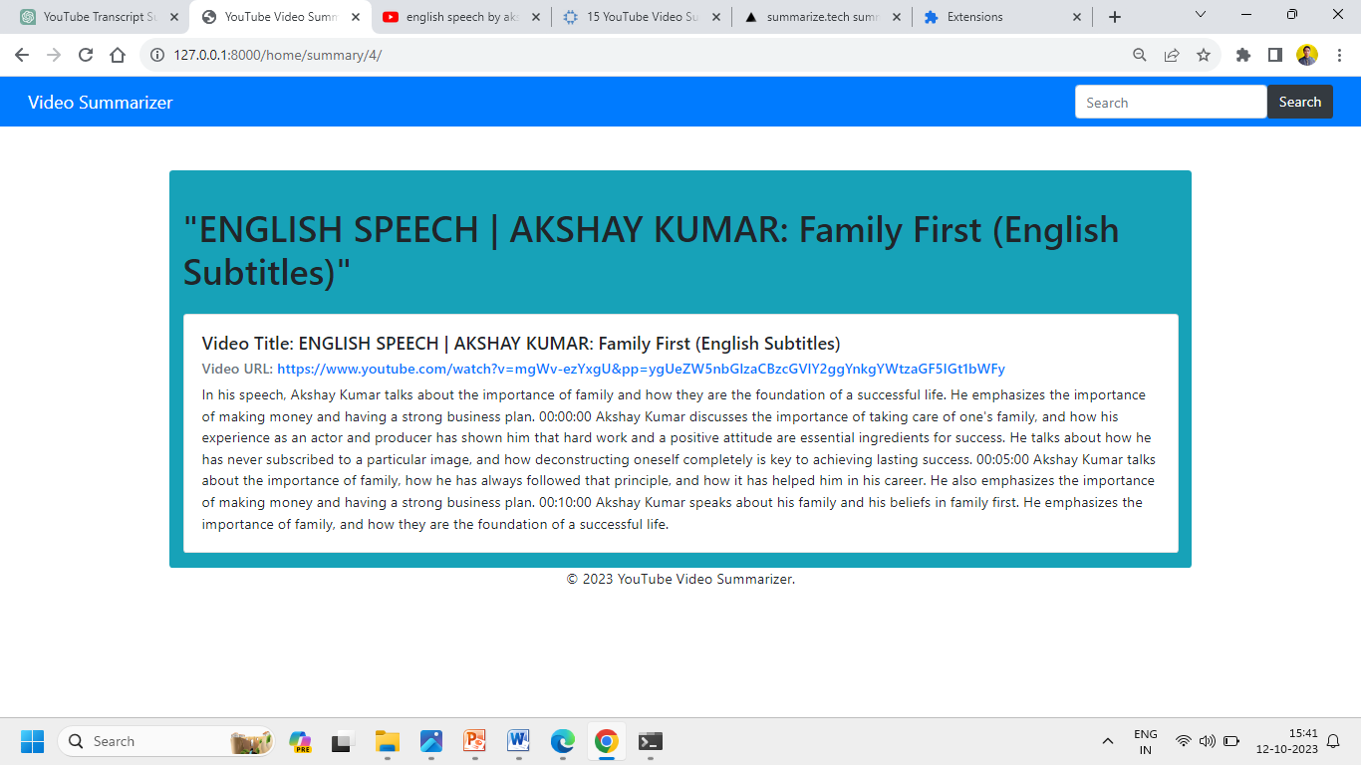
Screenshot :- 2

Slide 9
Benefits
Transcript summarizers offer several benefits that are:-
Time Efficiency:
Summarizers save time by covert transcripts into shorter & meaningful summaries.
Users can quickly grasp information without investing the time to listen to the entire video.
Study and Research:
Summarizers assist students, researchers, and professionals in quickly reviewing academic or technical content.
Summary can help review the content without watching entire video.
Enhanced Accessibility:
Enables easier understanding of video content, especially for those with limited time or accessibility issues.

Slide 10
Future Scope
Future scopes and updates to the YouTube Transcript Summarizer:
Multilanguage Support: Extend the tool to provide summary in multiple languages.
Integration with Video Platforms: Expand to support video platforms beyond YouTube.
User Customization: Allow users to customize summarization preferences.

Slide 11
Conclusion
Transcript summarizers are like magic tools that shrink big stories into short and clear summaries.
They are helpful when you want to know what's important in a video without watching all of it.
Summaries are like a friend giving you the most exciting parts of a story, so you don't miss out.
It's a time-saver and makes learning new things super easy!

Slide 12
THANK YOU
Thank you
All of you for your time and attention.

